Slide 1
Suturing Techniques and Wound Care AAPA Nashville Tn Paul M. Harrelson MPAS, PA-C DFAAPA Samford University Physician Assistant Program Chair/Program Director

Slide 2
No financial disclosures

Slide 3
Questions
1 Which of the following takes the longest time to heal?
a. Skin
b. Fascia
c. Mucosa
d. Peritoneum

Slide 4
2 You must close all layers when repairing a wound?
a. True
b. False

Slide 5
Which of the following local anesthetics provide the longest effect?
a. Novocaine?
b. Marcaine
c. Lidocaine
d. Carbocaine

Slide 6
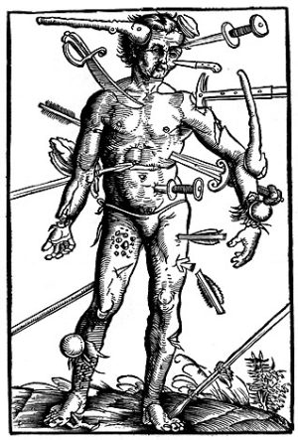
Wounds

Slide 7
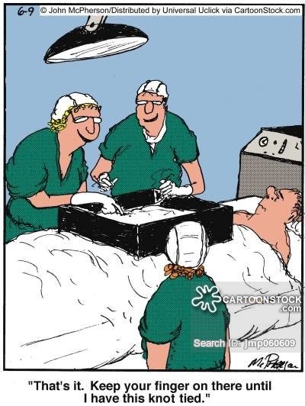

Slide 8
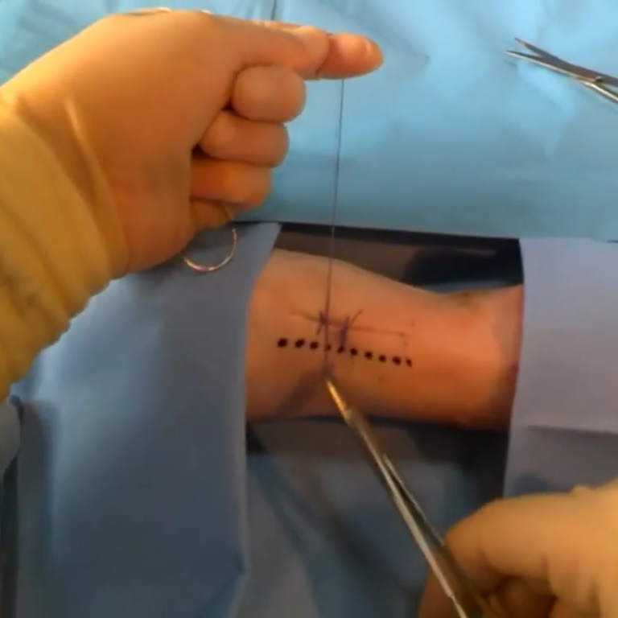
Learning Objectives
Understand Suturing principles
Describe wound healing principles
Comprehend suturing terms, suture types,
and commonly used suture techniques
Name of commonly used suture needles
Understand anesthetic and anesthetic techniques

Slide 9
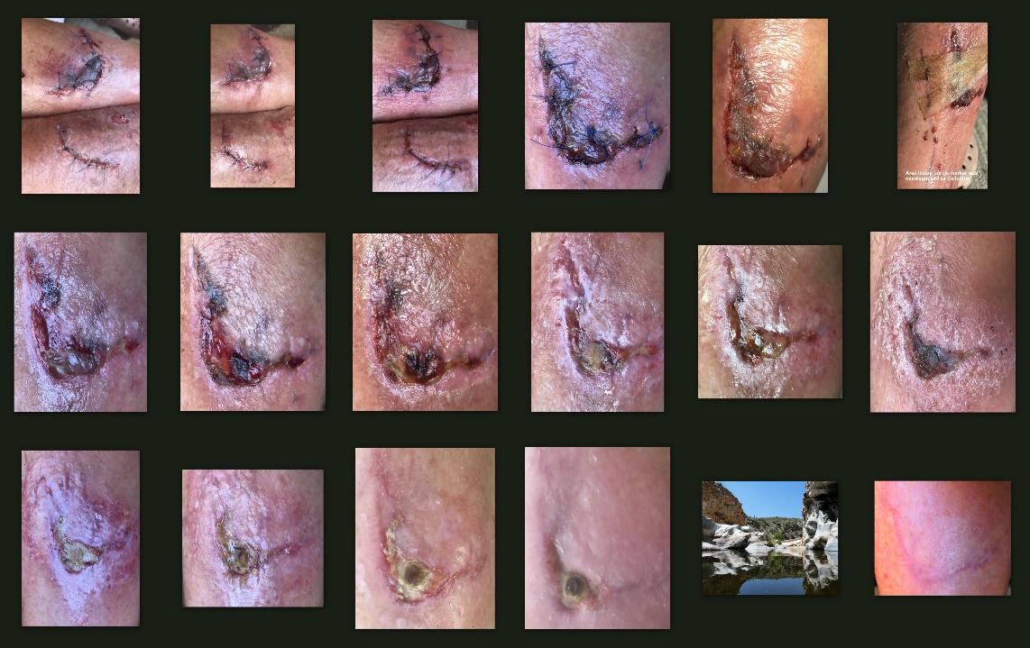
Wound Healing Concepts
Wound classification
Mechanism of injury
Tetanus/antibiotics/local anesthetics
Surgical principles and wound prep
Suture/needle/stitch choice
Management/care/follow-up

Slide 10
Healing factors
Patient’s:
Age
Vascular supply to tissue
Nutritional status
Tissue character
Prior injury
Treatment compliance
Excess adipose tissue
Chronic disease
Prior radiation therapy

Slide 11
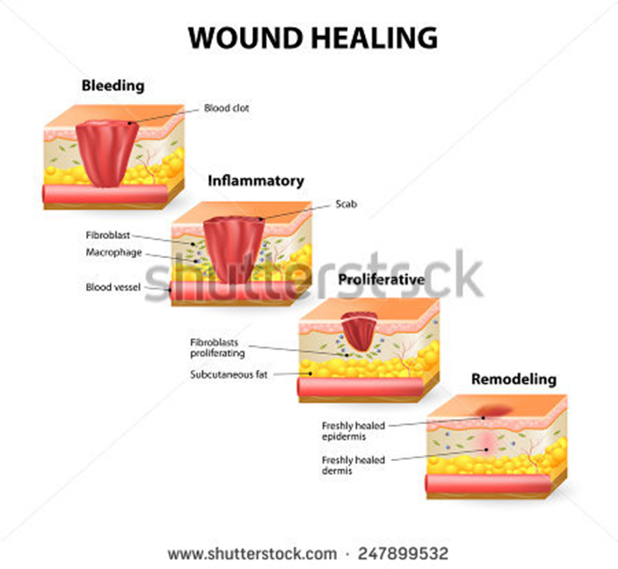
Model of Wound Healing
(1) Hemostasis: within minutes post-injury, platelets aggregate at the injury site to form a fibrin clot.
(2) Inflammatory: bacteria and debris are removed, and factors are released that cause the migration and division of cells involved in the proliferative phase.
(3) Proliferative: collagen deposition, granulation tissue formation, epithelialization, and wound contraction
(4) Remodeling: collagen is remodeled and realigned along tension lines and cells that are no longer needed are removed by apoptosis.
Notes:
Phases are sequential, yet overlap

Slide 12
Tissue healing timeline
Skin
5-7 Days
Mucosa
7-14 days
Subcutaneous
7- 14 days
Peritoneum
7-14 days
Fascia
14-28 days

Slide 13
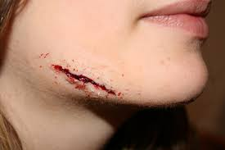
Wound Evaluation
When did the injury occur
How long ago
How did the injury occur
Size of wound
Depth of wound
Vessel/Tendon/nerve involvement

Slide 14
Wound Preparation:
Superficial Skin Wounds
Clean with saline, aqueous chlorhexidine or betadine.
Deep Wounds
Require exploration-anesthetized to assist with thorough cleaning
Removed foreign bodies.
Thorough irrigation with saline under pressure (with a 19 Ga needle on a 10-20 ml syringe)
Ragged Wounds
May have to trim tissue. May have to ellipse the wound
Glass Injuries
X-ray for possibility of retained glass.
If glass fragments are present, the wound needs exploration.

Slide 15
Common Injectable Local Anesthetics
Generic Name (trade name) | Drug Class | Available Concentration | Maximum Allowable Adult Doses | Average Onset Time | Average Duration Time
Procaine (Novocain) | Ester | 0.5%, 1%, 2% solutions | 1000mg (10-15mg/kg) | 1-5 minutes | 30-60 minutes
Lidocaine (Xylocaine) | Amide | 0.5%, 1%, 2% solutions | Without epi: 300mg (4.5mg/kg) | .05-30 minutes, varies by route given | 30 minutes to 3.5 hours
Mepivacaine (Carbocaine) | Amide | 1%, 2% solutions | 400mg (4.5mg/kg) | 1-10 minutes | 1-3 hours
Bupivacaine (Marcaine) | Amide | 0.25%, 0.5% solutions | Without epi: 175mg With epi: 225mg | 2-30 minutes | 8-16 hours

Slide 16
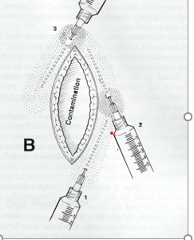
Field Blocks
Clean area and prep
Use 27-gauge needle to make wheal at the proximal angle of lesion
Using wheal infiltrate the first two sides of the square using long 22- or 25-gauge needle
At the distal aspect of the subdermal infiltration puncture the skin and complete the skin

Slide 17
Digital Block--finger
Anatomy--fingers are supplied with nerves at 2,5,7,10 o’clock position
With a 23- or 25-gauge needle inject 3 ml slowly around the circumference of finger at the base of anesthesia
Note--mechanical compression of the vascular supply may occur with large volume of local
Use caution when using Epinephrine in any digital block

Slide 18
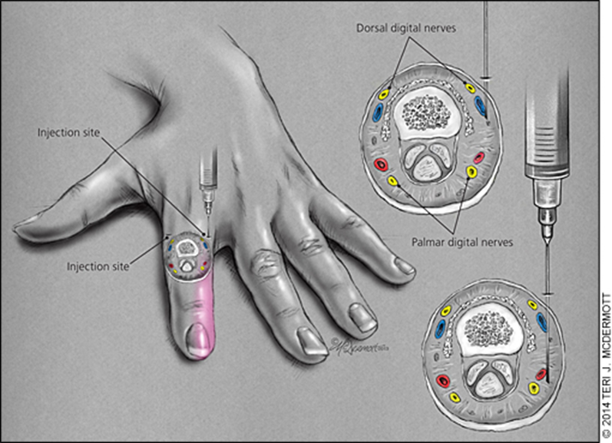
Digital Blocks--fingers

Slide 19
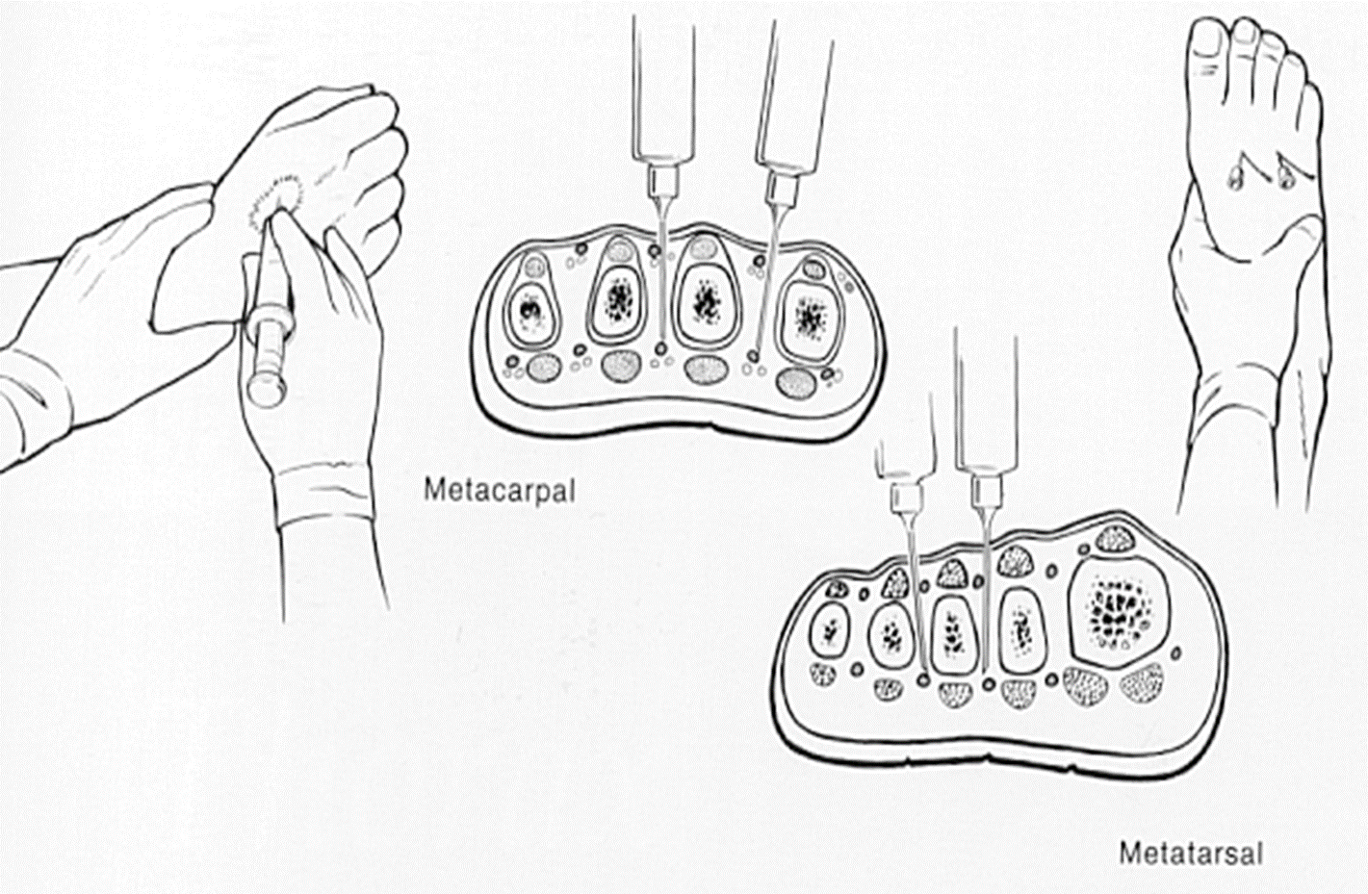
Digital Block--toes
Same as the as the digital block of the hand except need to use longer needle-1 ½ to 2-inch needle
Requires 5 to 8 ml of local injected between the metatarsal, most near the sole of the foot

Slide 20
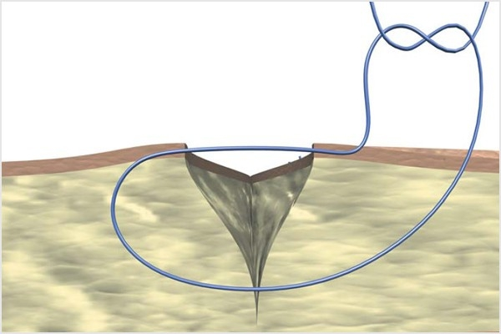
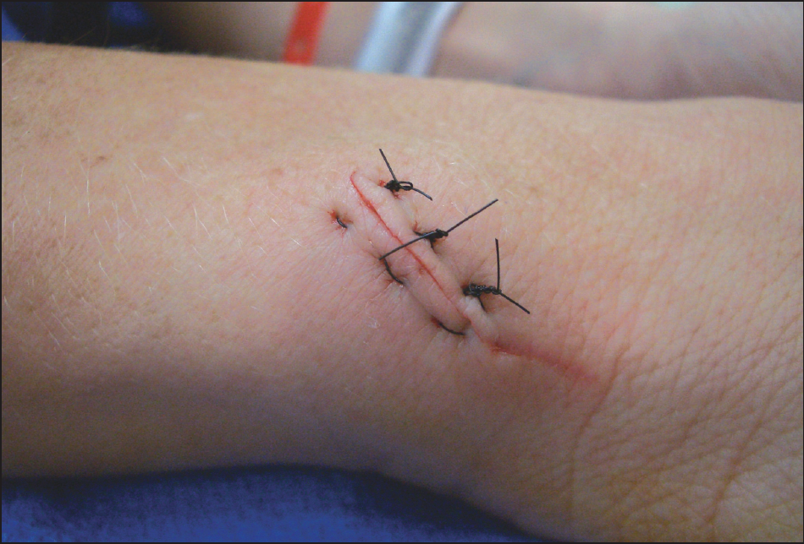
Why do we suture???
Approximate wound edges
Restoration of natural anatomic contours
To eliminate dead space
Minimize skin tension
Promotes wound healing
Affords a better cosmetic results

Slide 21
Contraindications to Suturing
Signs of gross infection
Puncture wounds
Bites- Human/Cat
Tendon, nerve, or vessel involvement
Injury occurring more than 12 hours on the torso or 24 hours of the face

Slide 22
Basic Suturing Principles
Be precise
Take your time
Use good lighting
Repair all layers-Muscle, fascia, dermis, skin
Evert skin edges
Approximate-not strangulate tissue edges

Slide 23
Principles Cont..
Always suture Right to left, or towards you
If Left handed-suture left to right
There are a couple of exceptions
Vertical and Horizontal mattress sutures
Handle tissue gently
Follow the needle arch- let the needle work for you
Tie secure, flat knots
Keep the number of suture to minimum
Know your limitation and know when to defer

Slide 24
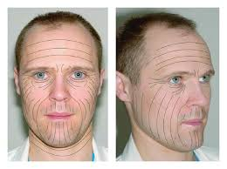
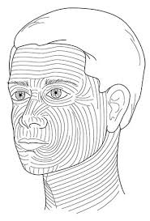
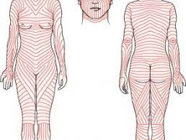
Langer’s lines

Slide 25
Classification of Suture
Absorbable
Non-absorbable
Multifilament
Monofilament

Slide 26
Suture Selection
Close slow healing tissues with non-absorbable sutures or long lasting absorbable.
Close fast healing tissues with absorbable suture-face, scalp
Contaminated area--avoid multifilament sutures which may lead to infection.

Slide 27
Suture Sizes
10-0 is the smallest
5 is the largest
10-0, 9-0, 8-0….. 0, 1, 2…5

Slide 28
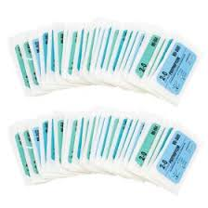
Suture Selection
Cosmetic surgery use the smallest appropriate suture.
Avoid using skin staples alone—suture underlying tissue if possible
Use subcuticular if possible.

Slide 29
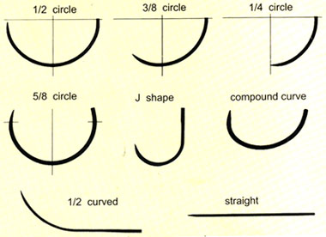
Needle types
Cutting
Taper

Slide 30
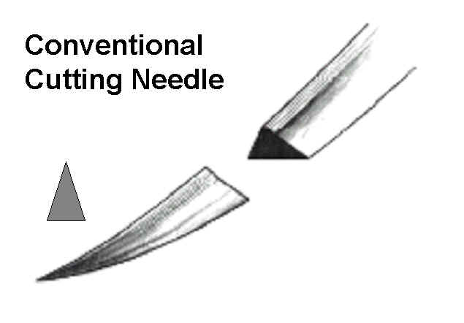
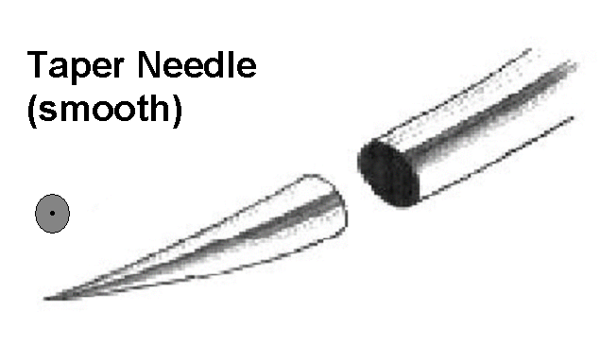
Needles
Curved
Cutting –usual for skin
Tapered-subcutaneous

Slide 31
Suture and Usage
Anatomical Wound Location | Tissue Layer to be Sutured | Suture Material Recommendation | Suture Technique
Face and Neck | Skin | 6-0 PAFG, Nylon, Polypropylene | Simple
 | Dermis | 6-0, 5-0 Vicryl, PDS | Inverted
 | Muscle | 4-0, 5-0 Vicyl, PDS | Simple
 | Perichondrium | 6-0 Vicryl | Simple
Mouth | Tongue | 4-0, 5-0 Vicryl, Chromic Gut | Simple; Inverted
 | Mucosa | Same as above | Simple; Inverted
Scalp | Skin | 4-0 Nylon, Polypropylene | Simple
 | Dermis | 4-0 Vicryl, PDS | Inverted
 | Muscle, Galea | 3-0, 4-0 Vicryl, PDS | Simple

Slide 32
Suture and Usage
Anatomical Wound Location | Tissue Layer to be Sutured | Suture Material Recommendation | Suture Technique
Arms and Legs (except hands and feet) | Skin | 4-0, 5-0 Nylon, Polypropylene | Simple; Mattress
 | Dermis | 4-0, 5-0 Vicryl, PDS | Inverted
 | Fascia | 3-0, 4-0 Vicryl, PDS | Simple
Hands | Skin | 5-0 Nylon, Polypropylene | Simple
 | Nail bed | 6-0 Vicryl | Simple
 | Dermis | 5-0 Vicryl, Nothing in Fingers | Inverted
Feet | Skin (Dorsum) (Plantar) | 4-0, 5-0 Nylon, Polypropylene | Simple; Mattress
 |  | 4-0, 5-0 Nylon, Polypropylene | Simple
 | Nailbed | 6-0 Vicryl | Simple
 | Dermis | 5-1 Vicryl; Nothing in Nailbed | Inverted

Slide 33
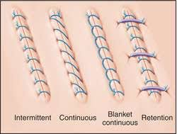
Suturing Techniques
Interrupted Suture
Simple
Horizontal Mattress
Vertical Mattress
Continuous Suture
Simple
Horizontal
Vertical
Locked running
Subcuticular Suture
Subcutaneous (Buried knot)
Modified
Simple with interrupted vertical mattress

Slide 34
Needle position-Incorrect

Slide 35
Needle position-Correct

Slide 36
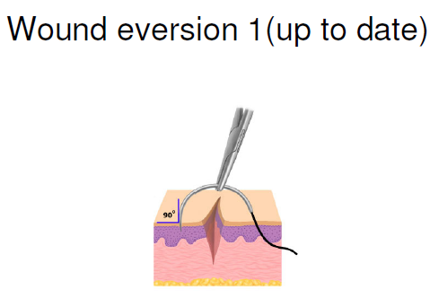
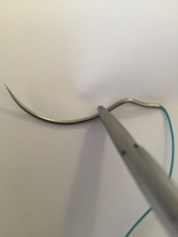
Suturing
The needle enters the skin approximately ¼ inch from wound edge at 90 degrees

Slide 37
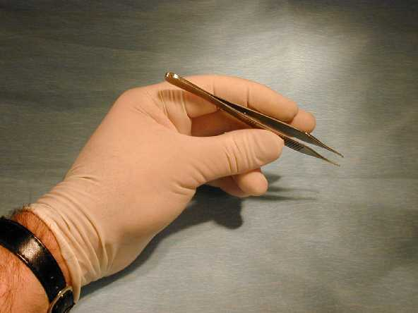
Forceps
Grasp forceps between thumb and index finger. Hold like a pen.

Slide 38
Simple Suture

Slide 39
Rule of Halves
3
1
2

Slide 40
Simple continuous

Slide 41
Vertical Mattress

Slide 42
Horizontal Mattress

Slide 43
Technique for Sub-Dermal Suture

Slide 44
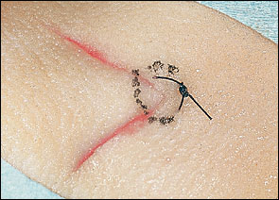
Half Buried Horizontal Mattress for Corner Flap (up to date)

Slide 45
Dog Ear Repair

Slide 46
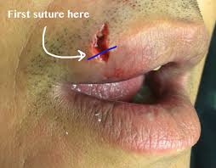
Lips
First suture at vermilion border.
Sutures: skin – 4/0, 5/0, Ethilon/Prolene
Mucosa and muscle - 4/0, 5/0 Vicryl
Inner lip-Sutures rarely needed

Slide 47
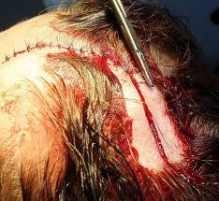
Scalp
Control excessive Bleeding with pressure at wound margin.
It is not usually necessary to shave any/much hair.
Close in 2 layers:
GALEA 3/0-5/0 Chromic Cat Gut (CCG) or PDS (absorbable)
SCALP 4/0-5/0 Nylon
Staples

Slide 48
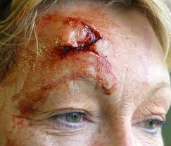
Forehead
Debride if necessary
Do not shave eyebrow
Sutures 5/0, 6/0 Nylon
Vicryl absorbable sutures
Superficial wound (± steri-strips/dermabond)

Slide 49
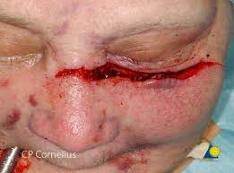
Cheek
Check for fractures (zygomatic arch Fx, blow out of orbit)
Should consult OMFS is fractured
involvement of facial nerve and muscle.
Ophthalmology if excessive swelling of the eyelid
Close as like forehead closure

Slide 50
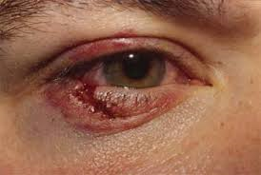
Eyelids
If lid involvement, then refer to Ophthalmology
Tarsal plate injury- refer Ophthalmology
May need plastic referral for aesthetics
Sutured without tension.
5/0,6/0 Vicryl or Fast Plain Gut absorbable sutures
May use Dermabond-be careful to not get in eye

Slide 51
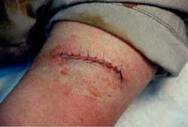
Limbs
May need immobilization of joint
Upper Limbs: 4/0, 5/0 Nylon. Deep sutures 4/0 PDS.
Trunk
Subcutaneous layer: 3/0, 4/0 Vicryl or PDS.
Skin: 4/0, 5/0 Nylon.

Slide 52
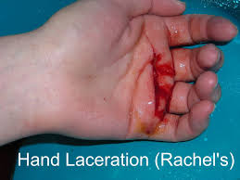
Digits & Hand
Small lacerations of fingertips with skin loss are very common.
Areas of skin loss up to 1 cm2 are treated with dressings and heal with good return of sensation.
May need Plastic surgeon referral.
Partial-amputation/crush injury (Finger)
Need to assess the integrity of the nail bed
Nail bed damage-refer to Plastic surgery for repair.
X-ray for distal fracture
Palm:
Be careful in assessing wound especially in very young children as deeper structures (eg nerves and tendons) may be involved. If in doubt consult Plastics.

Slide 53
Palate
Beware: Examine posterior pharynx for injury. May need to consult with OMFS.
Rare to suture only if gaping widely, extending through posterior free margin or continuing to bleed.
Tongue
Most lacerations do not require suturing.
IF laceration is large, extending through the free edge, full thickness or associated with ongoing bleeding, Plastics opinion is necessary.
Ear
If full thickness involving cartilage, needs Plastic opinion.

Slide 54
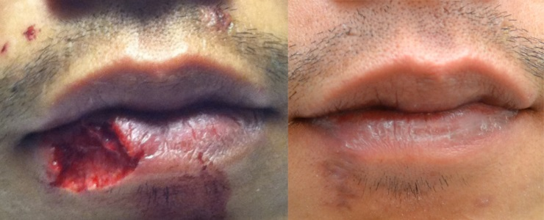
Lip Laceration repair

Slide 55
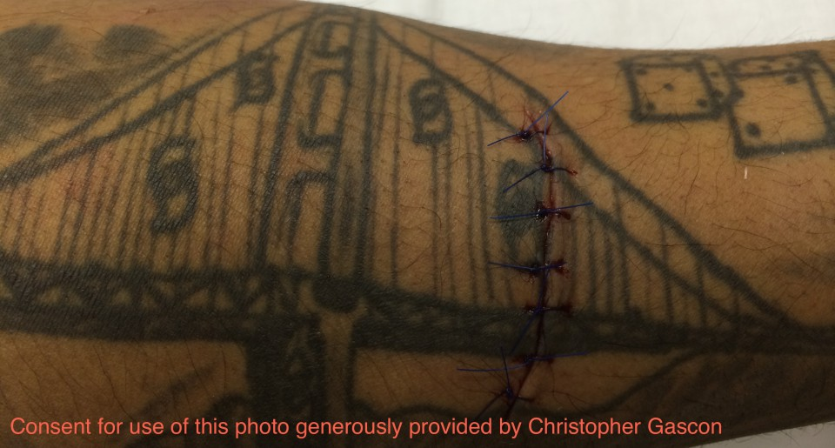
Body art/Piercing
Try to repair injury not disrupting the body art

Slide 56
Lip Laceration repair

Slide 57
Hand laceration repair

Slide 58
What would you do with this?????

Slide 59
Antibiotics
Simple lacerations-none needed
Most important decontamination of the wound
Bites and wounds with extensive tissue damage, or massive contamination-antibiotic needed
Recommended antibiotics
Augmentin 875mg BID for 10 days
If PCN allergy: Flagyl 500 TID and Doxycycline100 BID for 10 days

Slide 60
Suture Removal
Average time frame is 7 – 10 days
FACE: 3 – 5 d
NECK: 5 – 7 d
SCALP: 7 – 10 days
UPPER EXTREMITY and TRUNK: 10 – 14 days
LOWER EXTREMITY: 10-14 days
SOLES, PALMS, BACK OR OVER JOINTS: 10-14 days
Any suture gross signs of infections should be removed immediately.

Slide 61
When to Refer:
Wound type is above your skill to repair
Hand and feet with penetrating injury
Eye, Lip or ear with full thickness injury
Injury with nerve, large artery (you cannot gain control of bleeding) or bone fractures
Crushing injury of an extremity
Severely contaminated wound
Cosmetic repair uncertainties

Slide 63
Questions
1 Which of the following takes the longest time to heal?
a. Skin
b. Fascia
c. Mucosa
d. Peritoneum

Slide 64
2 You must close all layer when repairing a wound?
a. True
b. False

Slide 65
Which of the following local anesthetics provide the longest effect?
a. Novocaine?
b. Marcaine
c. Lidocaine
d. Carbocaine

Slide 66
Questions?????

Slide 67
References
Cartoon Stock one of 3, slide 3, 58
American Family Physician Essentials of Skin Laceration Repair, Oct 15, 2008 Issue Slide 30
Wayne LaMorte, M.D. Boston University Slide 36,39, 40
Veterinary Medicine 835 with Anderson/blackford at University of Tennessee - Knoxville Slide 40
Essential of Skin laceration repair, Randall T. Frosch MD, University of Michigan Medical School, slide 41
Nova Plastic Surgery web site, slide 54
Closing the Gap-Wound Closure fro the emergency practitioners-Christopher Gascon, slide 43, 53
Crashingpatient.com slide 43
Chen E et al. Primary Closure of Mammalian Bites. Acad EM 2000; 7(2): 157-162. Slide 53,54
NYSORA:Digital Nerve block https://www.nysora.com/digital-nerve-block

